Slide 1
Bright Coffee Shop
Analytical Review of Sales Trends and Performance

Slide 2
Purpose
Business Insights for a New CEO using Historical Transactional Data from Bright Coffee Shop

Slide 3
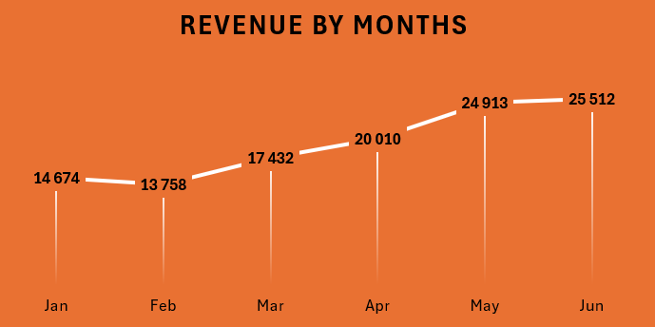
REVENUE | MONTHS
KEY INSIGHTS
Overall revenue shows a strong upward trend from 14,674 in January to 25,512 in June.
February saw a minor dip (–6%), likely due to seasonal factors.
From March onward, revenue grew steadily each month, with the highest jump between April and May (+24%).
By June, revenue increased over 70% compared to February.
Indicates consistent growth momentum and effective performance strategies after February

Slide 4
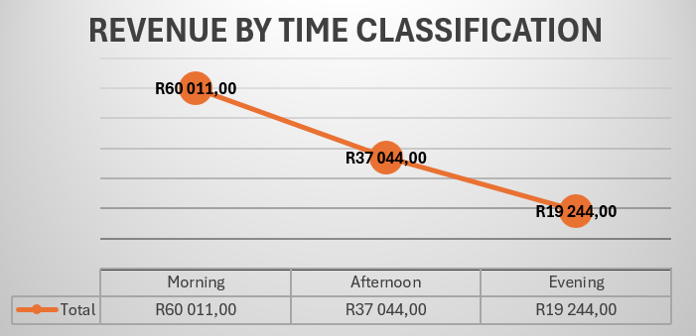

REVENUE| TIME CLASSIFICATION
KEY INSIGHTS
About 55% of sales occurred in the morning, while roughly 34% were generated in the afternoon, and only around 17% of sales came in the evening. This strong morning inclination highlights how the bulk of revenue is captured early in the day

Slide 5
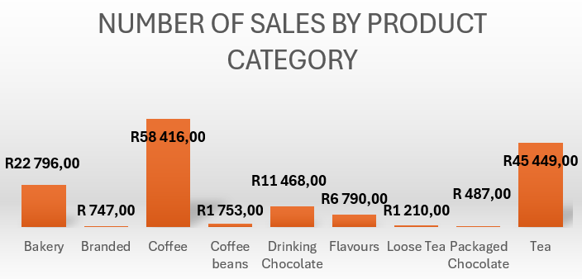
NUMBER OF SALES| PRODUCT CATEGORY
KEY INSIGHTS
75% of total sales come from Coffee, Tea, and Bakery categories, with Coffee leading at 35%.
The remaining categories, including Drinking Chocolate, Flavours, and others, contribute less than 25% combined — highlighting a strong customer preference for hot beverages and baked goods.

Slide 6
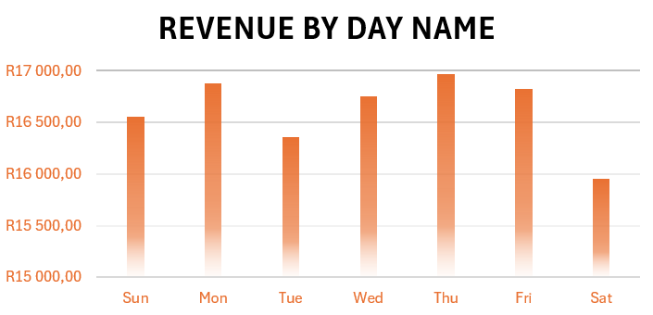
REVENUE|DAY NAME
KEY INSIGHTS
Thursday recorded the highest revenue, contributing approximately 17% of total weekly sales.
Monday followed closely with around 16%, showing strong performance at the start of the week.
Friday and Wednesday each accounted for roughly 15% of weekly revenue, indicating consistent mid-week sales.
Sunday contributed about 14% of total revenue.
Tuesday generated around 13%, while Saturday recorded the lowest revenue at approximately 10%.
Overall sales were strongest during weekdays, peaking on Thursday and Monday, and weaker over weekends.

Slide 7
RECOMMENDATIONS
2.Introduce promotions and bundles for low-selling items such as Branded, Packaged Chocolate, and Loose Tea.
1.Focus on high-performing products like Coffee, Tea, and Bakery to maintain strong sales momentum.
3. Use customer feedback and marketing campaigns to improve awareness of underperforming categories.
4. Ensure adequate stock and staffing on high-revenue days (Thursday and Monday).
Boost sales on low-performing days (Tuesday and Saturday) through discounts or loyalty rewards.

Slide 8
THANK YOU

